Slide 1

Web Application Testing
Final Project

Slide 2

Description
Web application
Online store for women and kids goods
Clothes made of wool and natural materials
Baptism Accessories
Delivery on the territory of Romania

Slide 3
Testing Approach
Test planning of the manual testing process
Exploratory testing to explore and learn how the software application works
Focus on the most important functionalities
Design test scenarios
Write the test cases and execute them
Identified the defects/bugs and report them
Write the Test report

Slide 4
Tools Used
MANTIS BUG TRACKER
BUG REPORTING
Microsoft Excel
Test case management
X mind Tool
Mind Maps
Snipping tool
Screenshots Capture
Microsoft word
Test Report

Slide 5

Testing types
Functional Testing
Exploratory Testing
Negative Testing
Positive Testing
Smoke Testing
Cross Browser Testing
UI Testing
Usability Testing
Security Testing
Performance Testing
Integration Testing
PERFORMED
APPLICABLE

Slide 6
Bugs Overview
Total: 16 Bugs

Slide 7
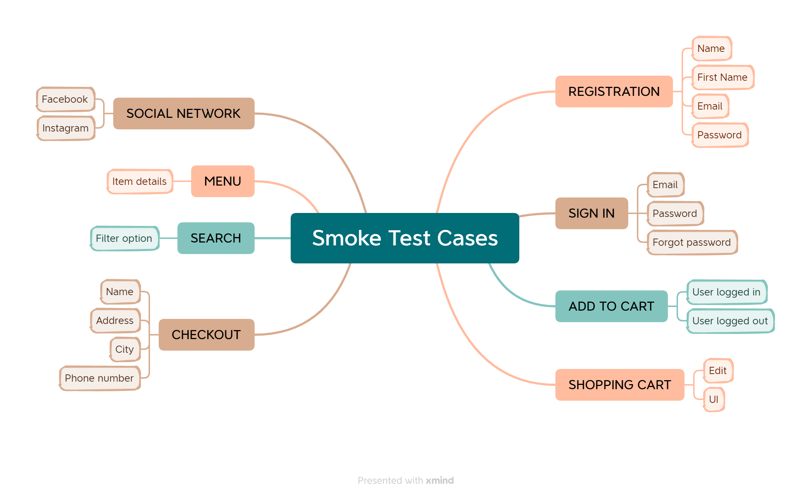
Test Cases Overview

Slide 8
Test Cases Results
Functionality | Total | Pass | Failed | Blocked | Not Run | Defects
Registration | 17 | 14 | 3 | 0 | 0 | 0052067, 0052081,0052089
Sign in | 8 | 8 | 0 | 0 | 0
Add to Cart | 12 | 10 | 2 | 0 | 0
Shopping Cart | 12 | 9 | 3 | 0 | 0 | 0052072, 0052099, 0052498
Checkout | 11 | 6 | 5 | 0 | 0 | 0052073, 0052102, 0052228, 0052225, 0052227
Overall Results | 60 | 47 | 13 | 0 | 0 | 11

Slide 9
Conclusions
60 Test Cases were executed of which 47 passes and 13 failed
16 Bugs were identified as 5 major,10 normal and 1 as improvement
Most of the bugs were identified through Exploratory Testing
Data type used during testing was: No data, Valid data, Invalid Data, Abnormal Data , Extreme Data
The software application requires fixing at least the major bugs

Slide 10
Lessons Learned
Learn and prioritize the basic functionalities of the software application
The lack of the requirements was a real challenge but not necessarily an inconvenience
Trying to find the best test coverage of the most important functionalities
Writing correct, concise and effective test cases
Finding and reporting bugs with all the steps

Slide 11
Thank you
onetiu.beatrix@gmail.com
Open for feedback or suggestions

